Slide 1
Efficient Influence Maximization
in Social Networks
Wei Chen, et al, “Efficient Influence Maximization in Social Networks”,KDD09’

Slide 2
OUTLINE
• Problem
• Previous Work
• New Greedy
• Degree Discount Heuristics
• Summary
• References

Slide 3
Problem Setting
•
Given
a limited budget B for initial advertising (e.g. free samples of product)
estimates for influence between individuals
Goal
trigger a large cascade of influence (e.g. further adoptions of a product)
Question
Which set of individuals should B target at?
•
•

Slide 4
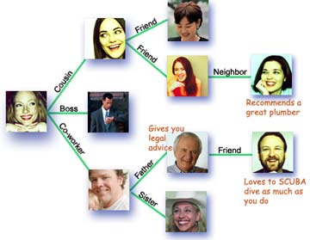
Problem Statement
•
•
•
Find a small subset of nodes in a social network that could maximize the
spread of influences.
Known as Influence Maximization
A.k.a Viral Marketing which makes use of “word-of-mouth marketing”
properties of social network

Slide 5
Problem Statement
•
•
Optimization problem first introduced by Domingos and Rechardson,
KDD2001, NP-hard to solve
Graph formulation introduced by Kempe, et al, KDD2003
Given:
✓ A graph G(V, E):
--Vertices: individuals in social network
--Edges:
connection or relationship
✓
k, size of output seeds
✓ A cascade model: LTM, ICM
Output:
S, a set of seeds (nodes) that maximize the expected number of nodes active in the end

Slide 6
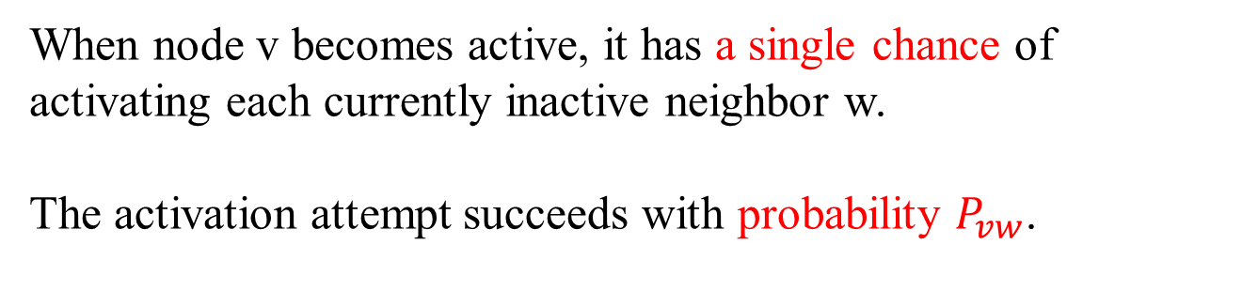
Problem Statement: Independent Cascade Model
When node v becomes active, it has a single chance of activating each currently inactive neighbor w.
The activation attempt succeeds with probability $P_{vw}$.
•
•

Slide 7
Problem Statement: Independent Cascade Model
0.6
Inactive Node
0.3
0.2
0.2
Active Node
X
U
Newly active
node
0.1
0.4
Successful
attempt
0.5
0.3
0.2
Unsuccessful
attempt
w
0.5
v
Stop!

Slide 8
Problem Statement: Linear Threshold Model
•
•
A node u has random threshold θu ~ U[0,1]
A node u is influenced by each neighbor v according to a weight buv witch
satisfies:
•
A node u becomes active when at least θu fraction of its neighbors are
active

Slide 9
Problem Statement: Linear Threshold Model
Inactive Node
0.6
Active Node
0.3
0.2
0.2
Threshold
X
Active neighbors
0.1
0.4
U
0.5
0.3
Stop!
0.2
w
0.5
v

Slide 10
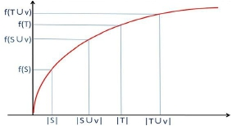
Problem Statement: submodular function
•
A set function is submodular if satisfies :
•
Important properties: the linear function of Submodular function is Submodular function

Slide 11

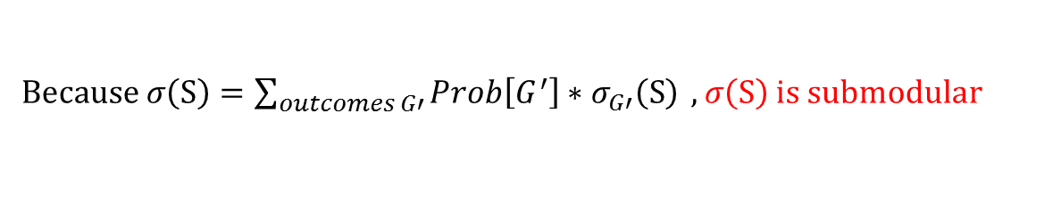
Problem Statement: submodular function
•
Monte Carlo : influence is estimated with R repeated simulations, we may determine first whether (u , v) is selected for propagation or not, and remove all edges not for propagation from G to obtain a new graph G’.
•
$σ\left(S\right)$ : the expected number of active nodes at the end of the process
•
$R_{G^{′}}(v)$: the number of nodes that v can reach
•
$σ_{G′}\left(S∪\left\{v\right\}\right)−σ_{G^{′}}\left(S\right)：the nodes in R_{G^{′}}(v)$but not in $σ_{G′}\left(S\right)$
•
$σ_{G′}\left(T∪\left\{v\right\}\right)−σ_{G′}\left(T\right)$：$the nodes inR_{G^{′}}(v)$but not in $σ_{G′}\left(T\right)$
$$σ_{G′}\left(T\right)≥σ_{G′}\left(S\right)$$
$$σ_{G′}\left(S∪\left\{v\right\}\right)−σ_{G′}\left(S\right)≥σ_{G′}\left(T∪\left\{v\right\}\right)−σ_{G′}\left(T\right)$$
$Because σ\left(S\right)=\sum_{outcomes G′}{Prob\left[G^{′}\right]∗σ_{G′}\left(S\right)} ,σ\left(S\right)$ is submodular

Slide 12
Problem Statement: submodular function
Bad News : For a submodular function f , if f only takes non-negative value, and is monotone, finding a k-element set S for which f(S) is maximized is an NP-hard optimization problem.
Good News :We can use Greedy Algorithm!
Start with an empty set S
For k iterations:
Add node v to S that maximizes f(S +v) - f(S).
How good it is?
Theorem: The greedy algorithm is a (1 – 1/e) approximation.
The resulting set S activates at least (1- 1/e) > 63% of the number of nodes that any size-k set S could activate.

Slide 13
OUTLINE
• Problem
• Previous Work
• New Greedy
• Degree Discount Heuristics
• Summary
• References

Slide 14
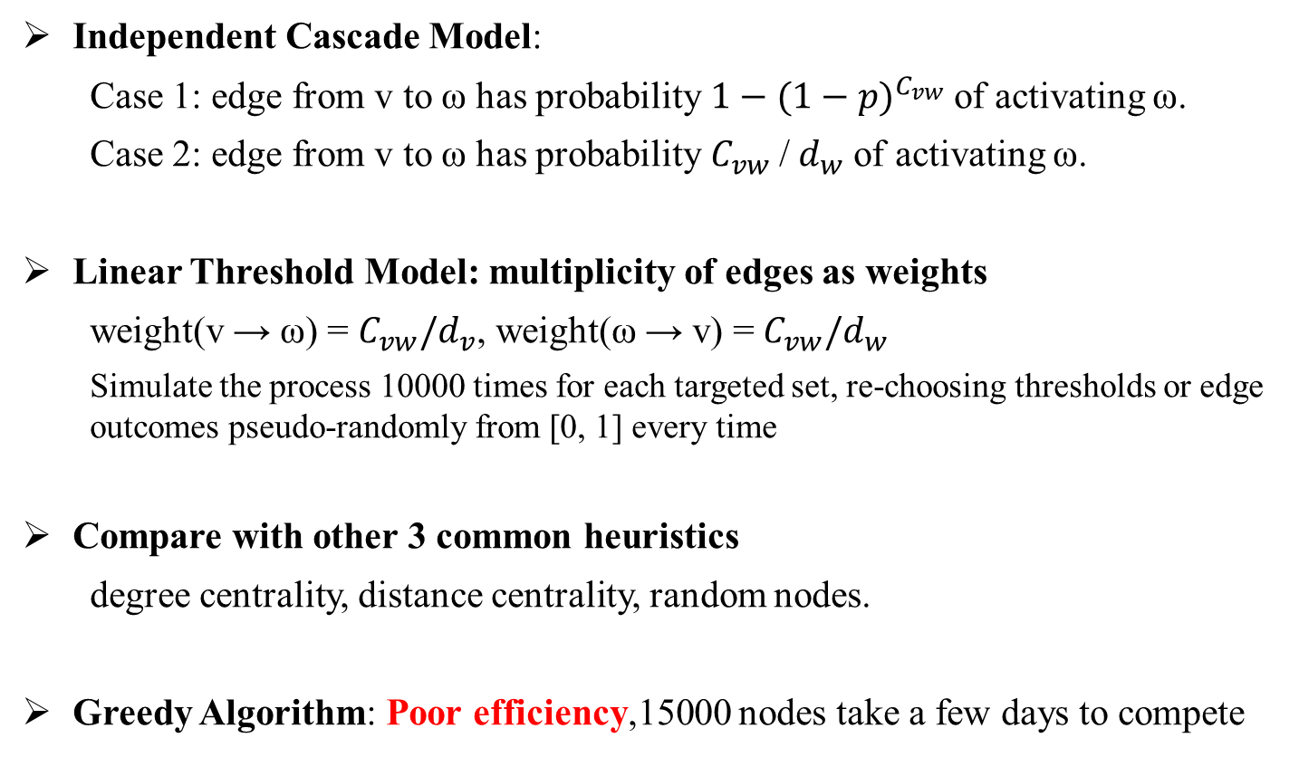
Previous Work
“Maximizing the Spread of Influence Through a Social Network”
Independent Cascade Model:
Case 1: edge from v to ω has probability ${1−(1−p)}^{C_{vw}}$of activating ω.
Case 2: edge from v to ω has probability $C_{vw}$/ $d_{w}$of activating ω.
Linear Threshold Model: multiplicity of edges as weights
weight(v → ω) = $C_{vw}/d_{v}$, weight(ω → v) = $C_{vw}/d_{w}$
Simulate the process 10000 times for each targeted set, re-choosing thresholds or edge outcomes pseudo-randomly from [0, 1] every time
Compare with other 3 common heuristics
degree centrality, distance centrality, random nodes.
Greedy Algorithm: Poor efficiency,15000 nodes take a few days to compete

Slide 15
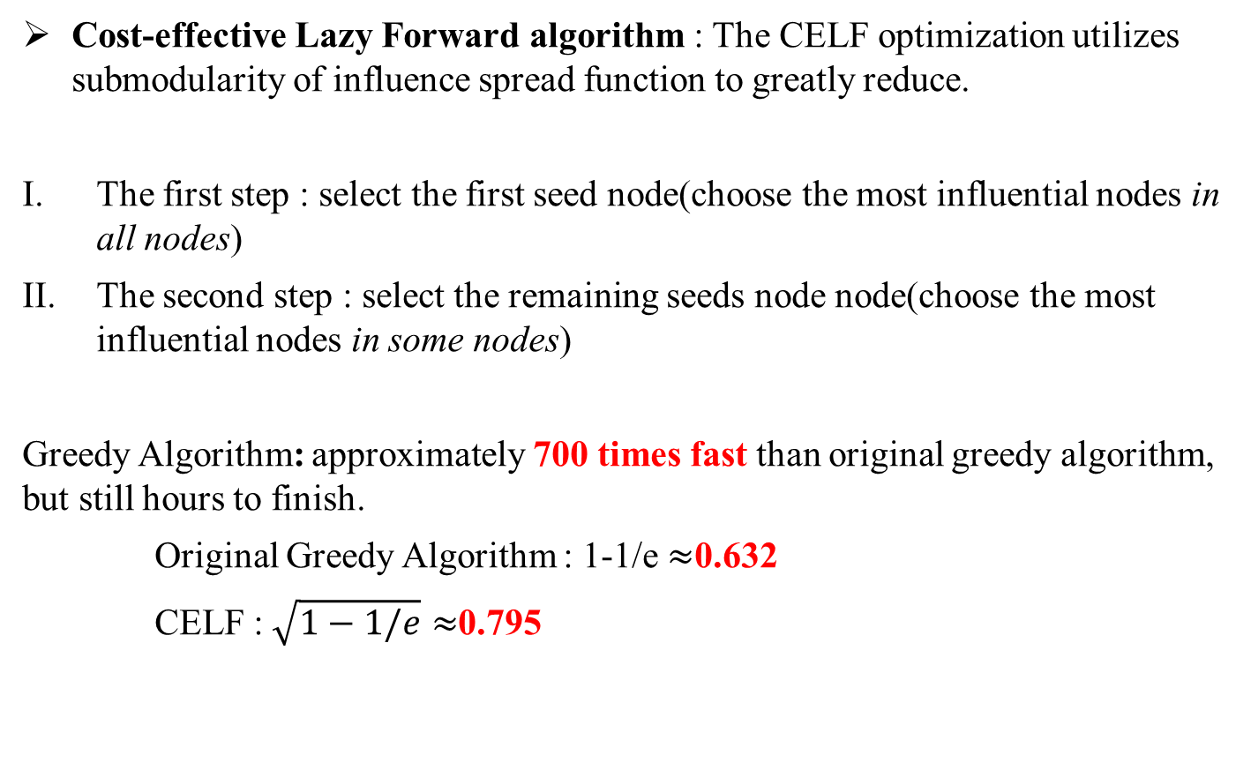
Previous Work
“Cost-effective Outbreak Detection in Networks”
Cost-effective Lazy Forward algorithm : The CELF optimization utilizes submodularity of influence spread function to greatly reduce.
The first step : select the first seed node(choose the most influential nodes in all nodes)
The second step : select the remaining seeds node node(choose the most influential nodes in some nodes)
Greedy Algorithm: approximately 700 times fast than original greedy algorithm, but still hours to finish.
Original Greedy Algorithm : 1-1/e $≈$0.632
CELF :$\sqrt{1−1/e}≈$0.795

Slide 16
OUTLINE
• Problem
• Previous Work
• New Greedy
• Degree Discount Heuristics
• Summary
• References

Slide 17
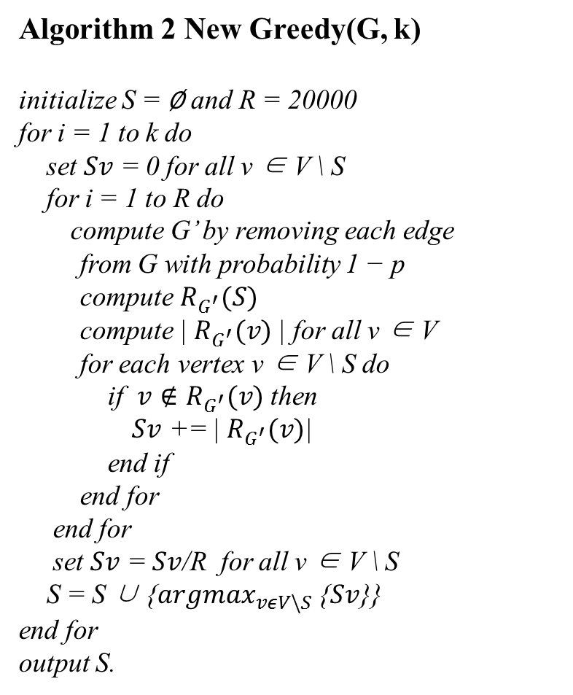
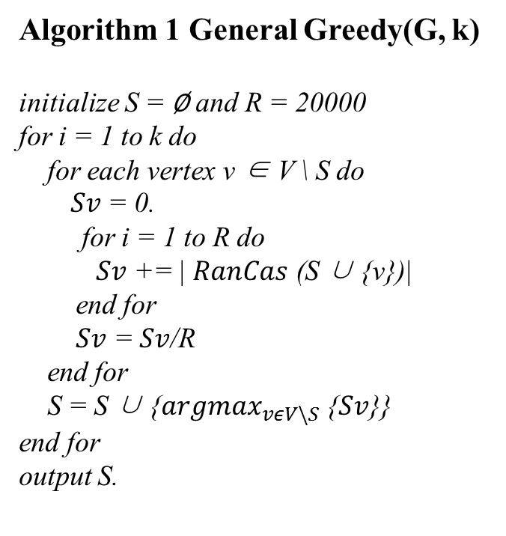
New Greedy
Algorithm 1 General Greedy(G, k)
initialize S = ∅ and R = 20000 for i = 1 to k do
for each vertex v ∈ V \ S do
$Sv$ = 0. for i = 1 to R do
$Sv$ += | $RanCas$ (S ∪ {v})| end for $Sv$ = $Sv$/R end for S = S ∪ {${argmax}_{vεV\backslash S}$ {$Sv$}} end for output S.
Algorithm 2 New Greedy(G, k)
initialize S = ∅ and R = 20000 for i = 1 to k do
set $Sv$ = 0 for all v ∈ V \ S for i = 1 to R do compute G’ by removing each edge
from G with probability 1 − p compute $R_{G^{′}}(S)$ compute | $R_{G^{′}}(v)$| for all v ∈ V for each vertex v ∈ V \ S do if $v∉R_{G^{′}}(v)$ then $Sv$ += | $R_{G^{′}}(v)$| end if end for end for set $Sv$ = $Sv$/R for all v ∈ V \ S S = S ∪ {${argmax}_{vεV\backslash S}$ {$Sv$}} end for output S.

Slide 18
OUTLINE
• Problem
• Previous Work
• New Greedy
• Degree Discount Heuristics
• Summary
• References

Slide 19
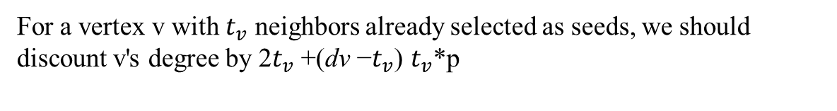
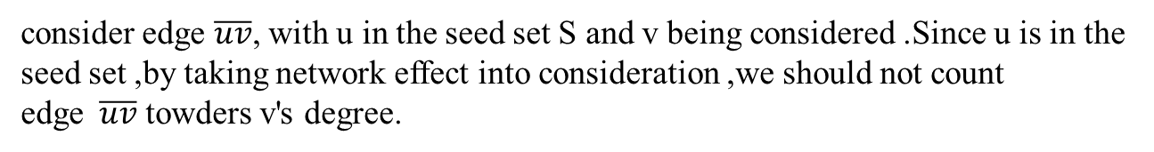
Degree Discount Heuristics
• Basic Idea:
consider edge $\overline{uv}$, with u in the seed set S and v being considered .Since u is in the seed set ,by taking network effect into consideration ,we should not count edge$\overline{uv}$ towders v's degree.
• Conclude:
For a vertex v with $t_{v}$ neighbors already selected as seeds, we should discount v's degree by 2$t_{v}$ +(dv −$t_{v}$) $t_{v}$*p

Slide 20
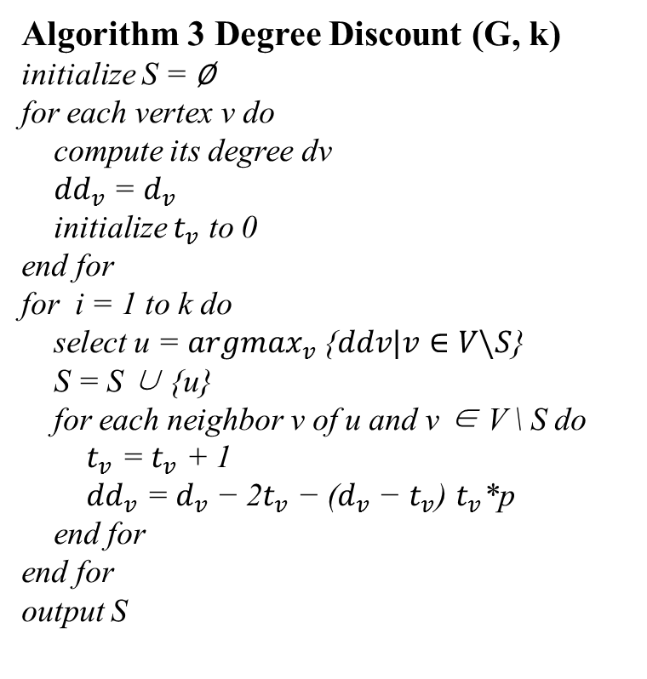
Degree Discount Heuristics
Algorithm 3 Degree Discount (G, k) initialize S = ∅ for each vertex v do
compute its degree dv ${dd}_{v}$ = $d_{v}$ initialize $t_{v}$ to 0
end for
for i = 1 to k do select u = ${argmax}_{v}$ {$ddv|v∈V\backslash S$} S = S ∪ {u} for each neighbor v of u and v ∈ V \ S do ${ t}_{v}$ = $t_{v}$ + 1 ${ dd}_{v}$ = $d_{v}$ − 2$t_{v}$ − ($d_{v}$ − $t_{v}$) $t_{v}$*p end for end for output S

Slide 21
Degree Discount Heuristics
• High Efficiency:
Amazingly reduces the running time by over six orders of magnitude with less than 3.5%
degradation in performance.
• Motivation:
Conventional degree/centrality based heuristics perform poorly in practical scenarios because
they ignore the network effect.
Important Fact: Since many of the most central nodes may be clustered, targeting all of them is
not at all necessary.

Slide 22
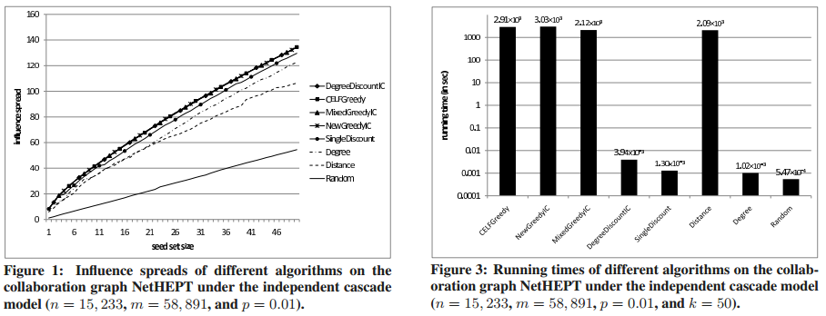
Degree Discount Heuristics
• Evaluations on NetHEPT:
Single Discount heuristic : reduced approximately half of the gap between Greedy and Degree
The most interesting result is on Degree Discount heuristic

Slide 23
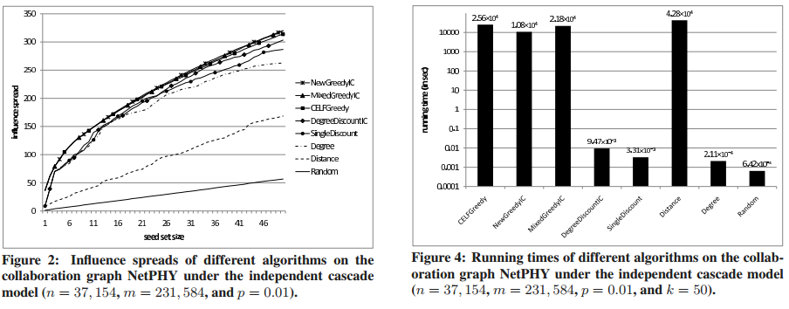
Degree Discount Heuristics
• Evaluations on NetPHY:
Degree Discount heuristic : it is also very close to CELF (only 3.4% lower for k = 50).

Slide 24
OUTLINE
• Problem
• Previous Work
• New Greedy
• Degree Discount Heuristics
• Summary
• References

Slide 25
Summary
When short running time is important, we should choose Single Discount and Degree Discount.
When running time is not a major concern but guaranteed influence spread is essential, we can use CELF or Mixed Greedy algorithms for seed selection.
•
•

Slide 26
Summary
•
•
•
The current influence maximization problem is simplified, without
considering other features in social networks, such as community structures
and small-world phenomenon.
The author suggests that we should focus our research efforts on searching
for more effective heuristics for different influence cascade model in real life
influence maximization anpplications
More sophisticated heuristics are promising, such as taking into
consideration multiple links between nodes, higher-order influences, cross-
neighborhood structure…

Slide 27
OUTLINE
• Problem
• Previous Work
• Degree Discount Heuristics
• Summary
• References

Slide 28
References
•
•
D. Kempe, J. Kleinberg and E. Tardos, “Maximizing the Spread of Influence through a Social Network”, KDD 2003
J. Leskovec, A. Krause, C. Guestrin, C. Faloutsos,J. VanBriesen, and N. S. Glance. “Cost-effective outbreak detection in networks”. KDD 2007

Slide 29
Thank you !

